Slide 1

Welcome to Introduction to Python – Level 2
What do you need to get started?
You must have completed Level 1
Python (3.3.5): https://www.python.org/downloads/
PyCharm: http://www.jetbrains.com/pycharm/download/
(Make sure you download this before the class and you have right version for your platform, Windows or Mac)
Class time: 2 hrs.
Wi-Fi: Free-WiFi

Slide 2

Who is helping you today?
Anoop Trivedi: Instructor
Arun Gupta: Instructor
Aarthi Rao: Instructor
Pradeep Bhatter: Instructor

Slide 3
What are we going to do today ?
Brush up from Lesson 1 – Guessing Game
Play with list, tuples, and dictionary
Basics of functions
Passing parameters to functions
Passing Tuples and Dictionary to functions
Introduction to Tkinter
Lets Play Hangman!

Slide 4
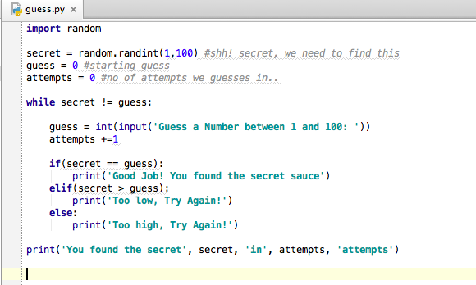
Mission: Find my secret number?
Computer has generated a secret number, can you hack it?

Slide 5
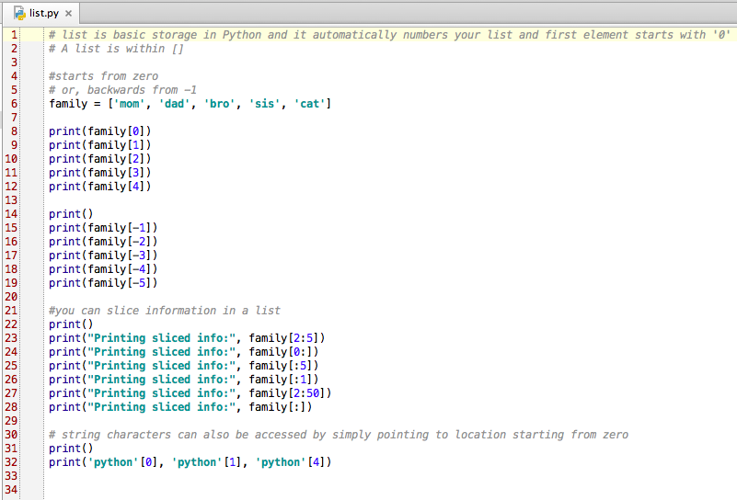
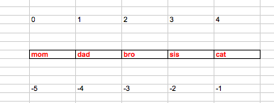
Slicing List:

Slide 6
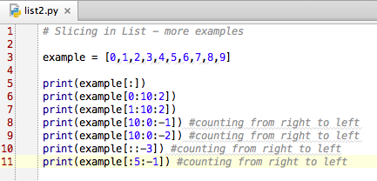
More ways of Slicing List:

Slide 7
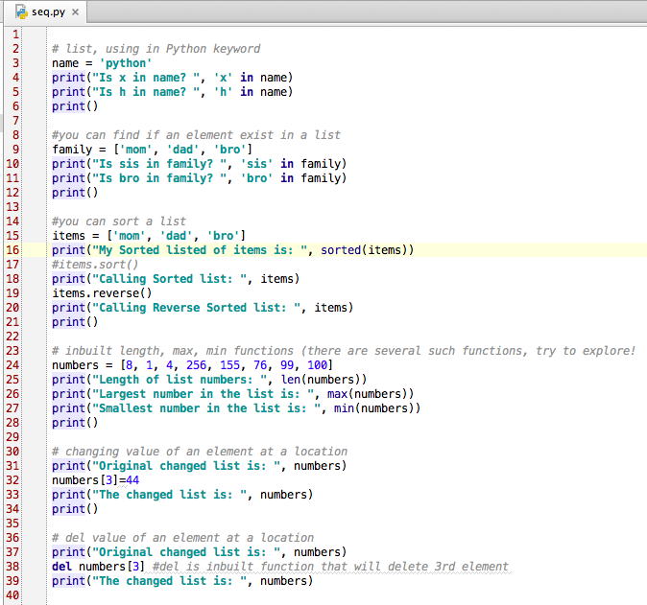
Calling in-built methods

Slide 8
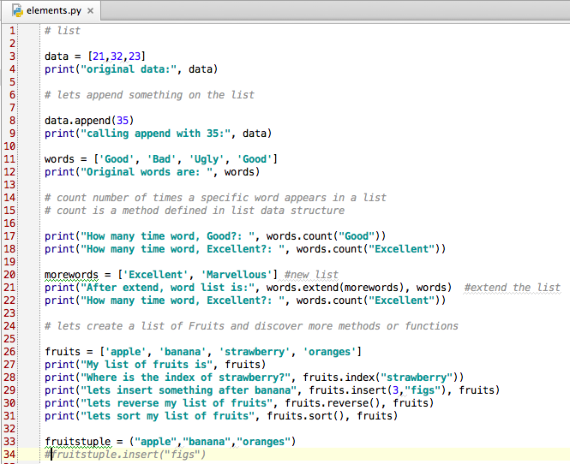
More about Lists and Tuples

Slide 9
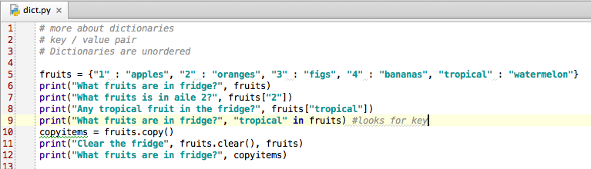

More about Dictionaries
Loop through a
dictionary

Slide 10
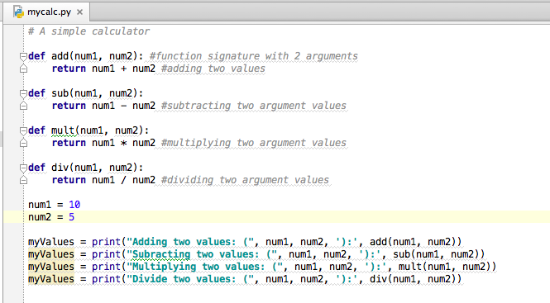
Introduction to Methods: Basic Calc

Slide 11
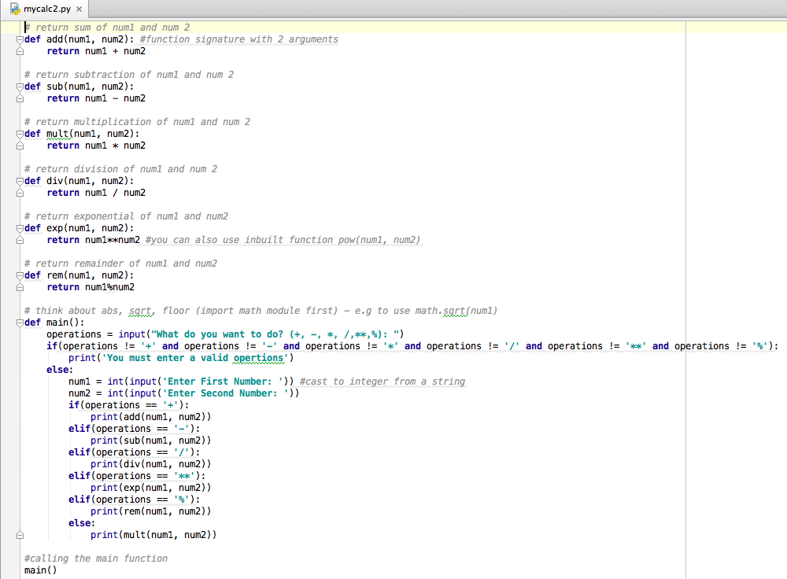
Advance Calculator:

Slide 12
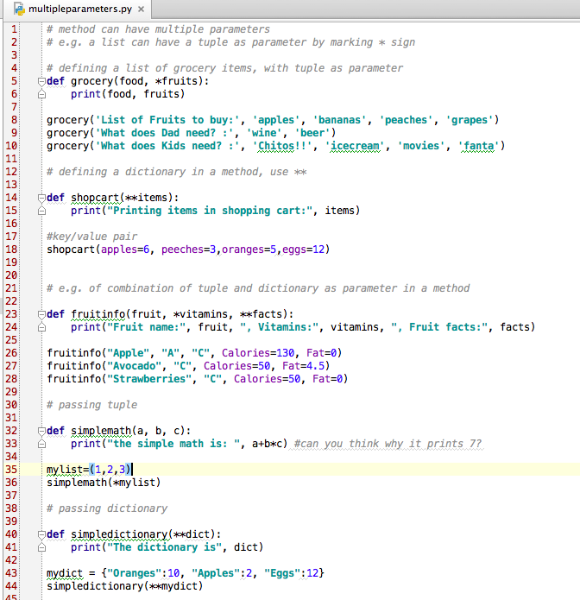
Passing Tuples and Dictionaries:
Passing tuples and dictionaries
as parameters

Slide 13








Lets Build & Play Hangman!

Slide 14
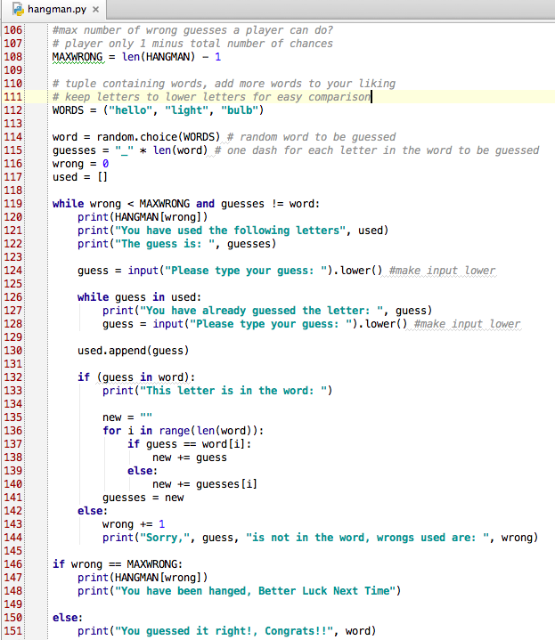
Hangman!
‘and’ example
Nested statements

Slide 15
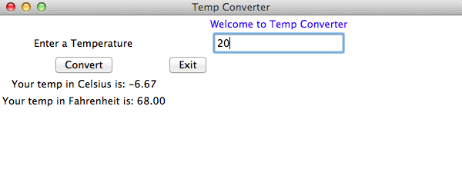
Introduction to Tkinter – Temp Converter App

Slide 16
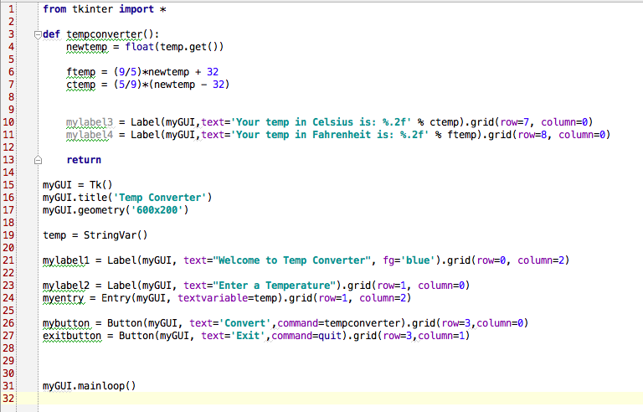
Temp Converter App

